Slide 1
Youtube Songs Analysis
By: Habiba Mohamad Atiia

Slide 2
01
The goal

Slide 3
The aim is to use Power BI for insightful visualizations and reports to better understand the performance, popularity, and user engagement of YouTube songs. This analysis seeks to reveal trends, preferences, and patterns to help content creators and stakeholders optimize their YouTube song content.

Slide 4
02
Dataset Description

Slide 5
video_id
channelTitle
title
description
tags
publishedAt
viewCount
likeCount
favoriteCount
commentCount
duration
definition
caption

Slide 6
03
Data Cleaning and Preparation

Slide 7
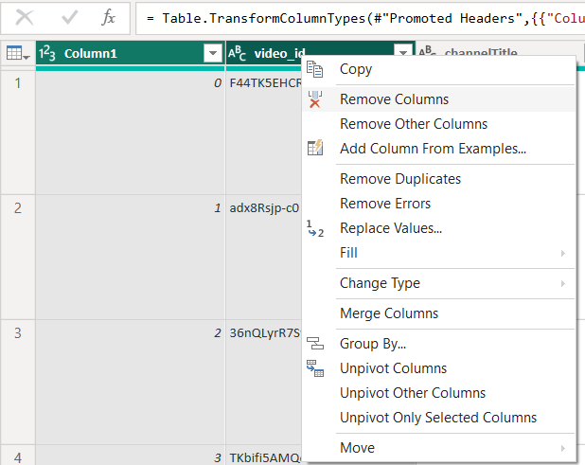
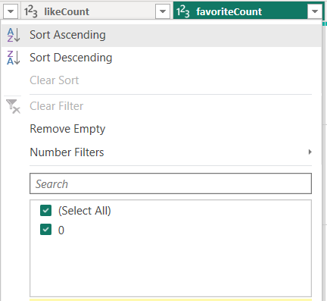
Removing unwanted columns
- Because it has only one value, which is zero.

Slide 8
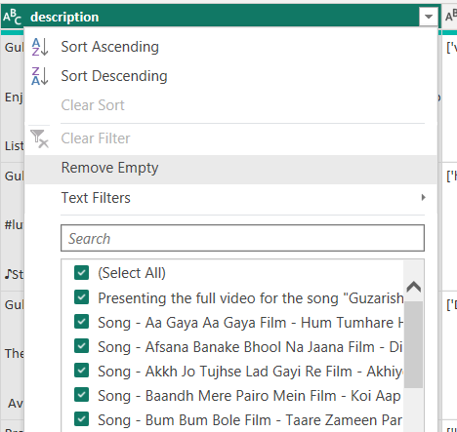
Removing Nulls from description column

Slide 9
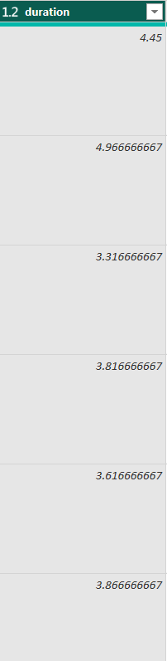
Changing duration time into total minutes

Slide 10
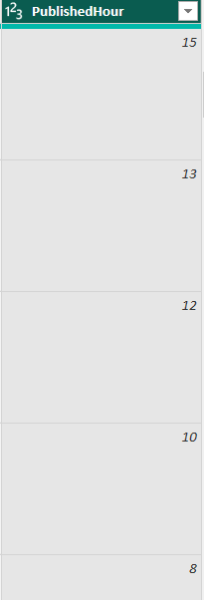
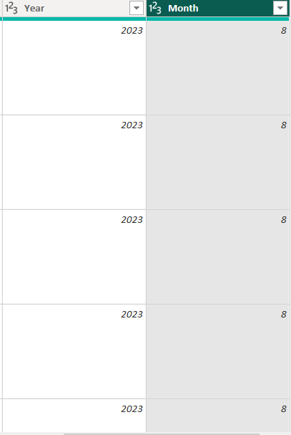
splitting

Slide 11
04
Dashboards

Slide 12
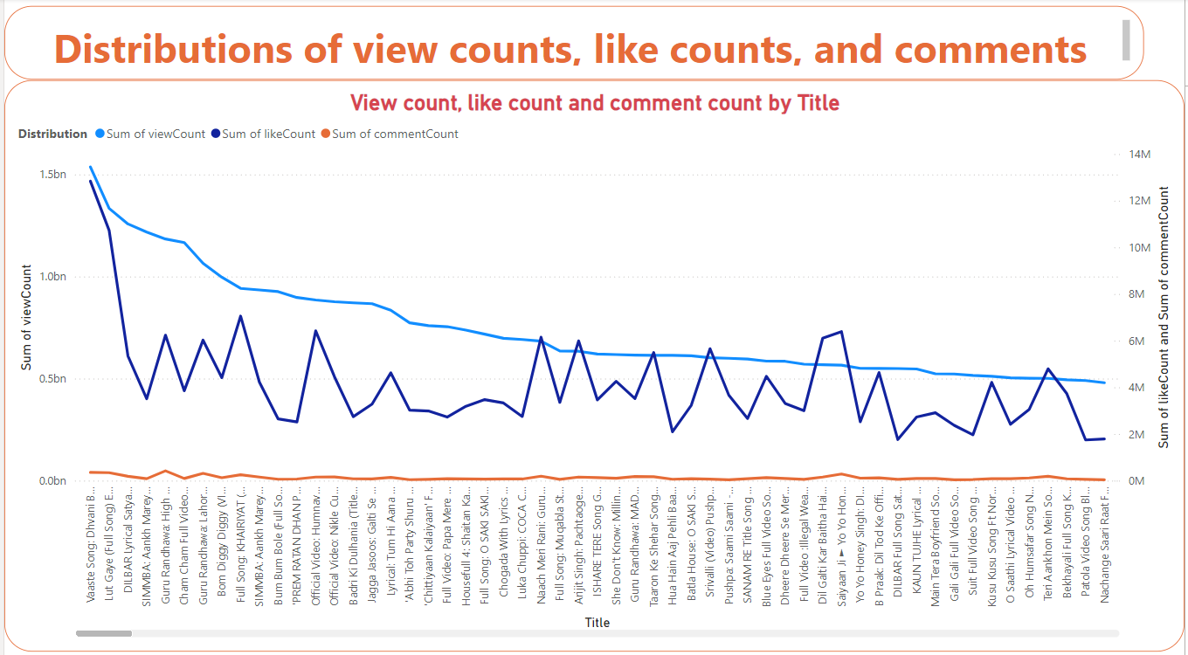

Slide 13
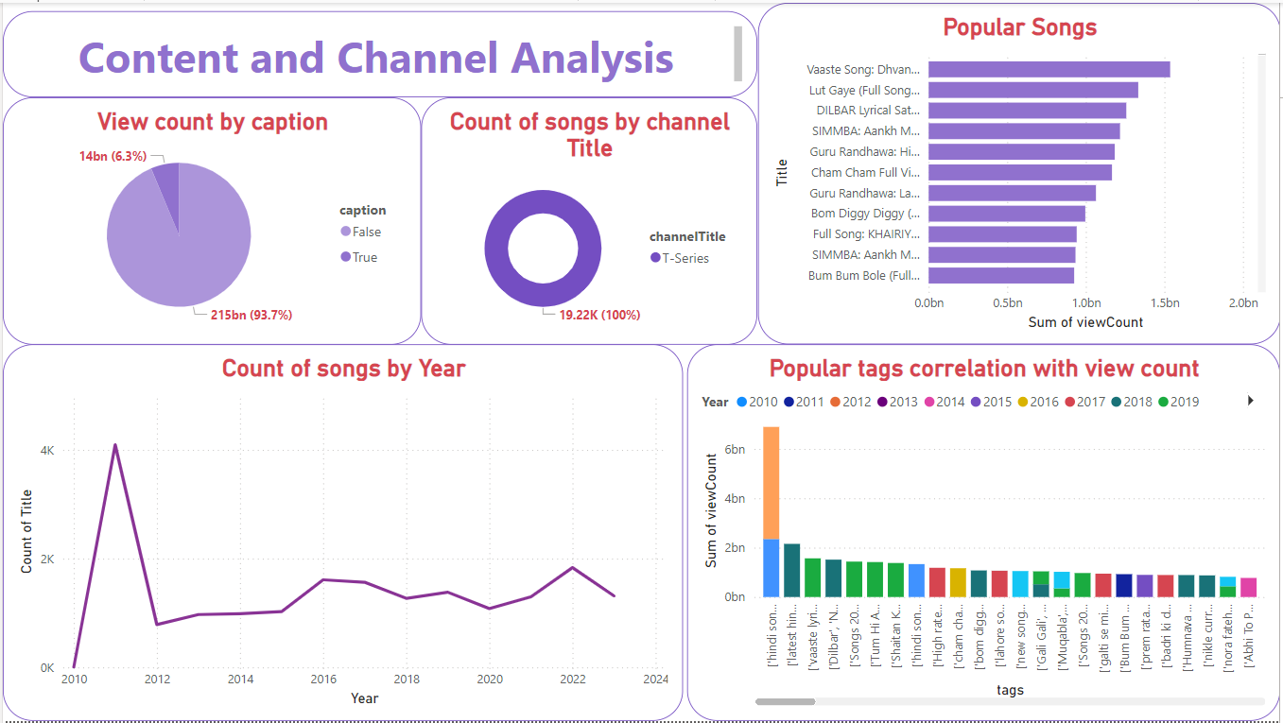

Slide 14
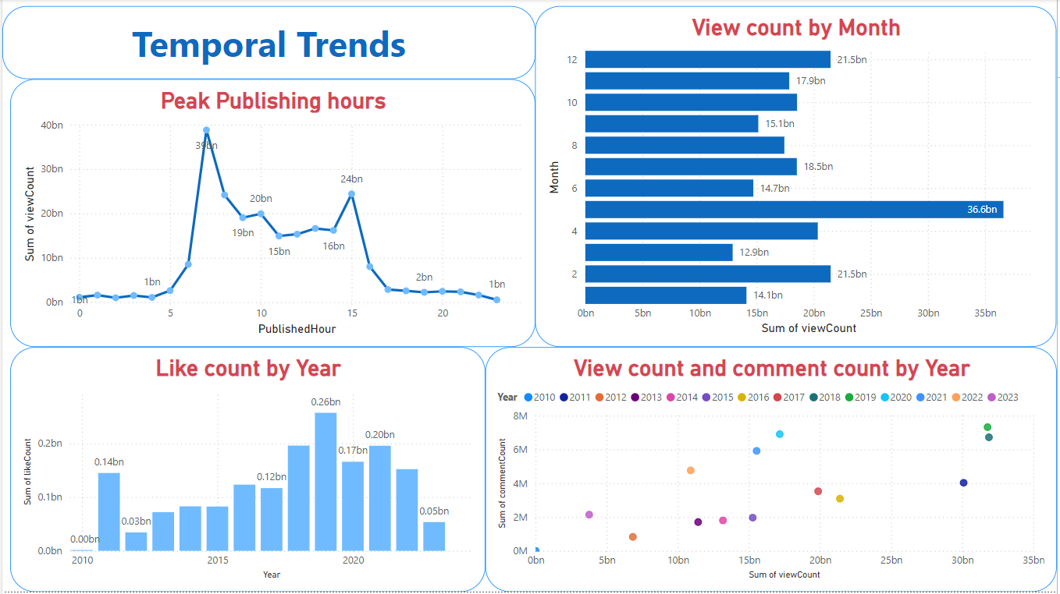

Slide 15
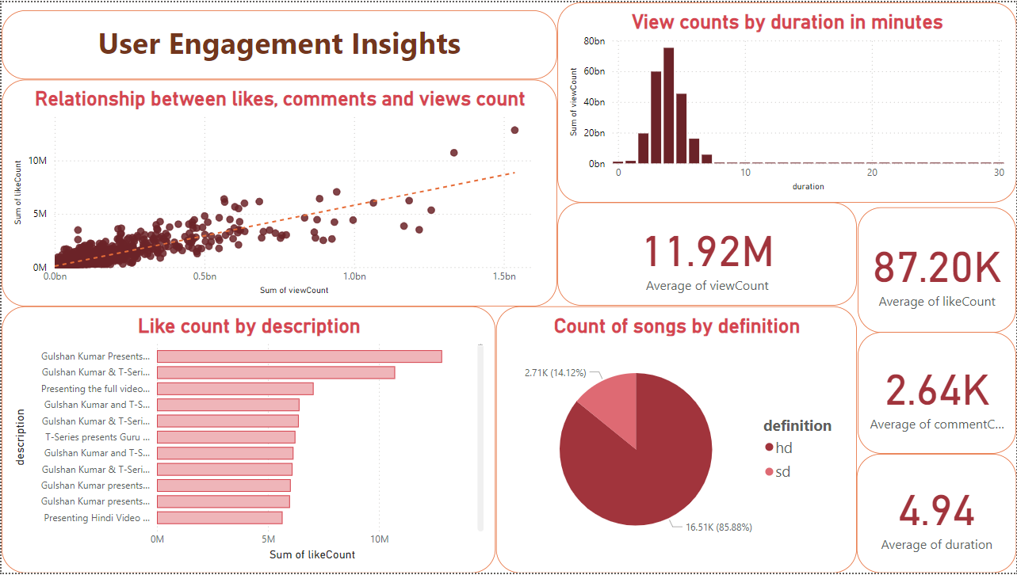

Slide 16
05
Recommendations

Slide 17
Regularly monitor and analyze performance metrics.
Develop compelling and informative titles.
Share videos in online communities and forums.
Foster viewer engagement through interactive polls and Q&A sessions.
Use relevant tags for search visibility.
Design visually appealing thumbnails.
Collaborate with influencers or brands.
Encourage viewers to subscribe, like, and share the content.
Structure content into playlists to increase viewing duration.

Slide 18
Thank You

